Slide 1
形式语言与自动机理论 S2-2 有限状态自动机
李钦 副教授
华东师范大学
软件工程学院

Slide 2




确定的有限状态自动机(DFA)
A Deterministic Finite Automaton $DFA=(Q,Σ,δ,q_{0},F)$
$Q$ is a finite set of states
$Σ$ is a finite set of input symbols
$δ:Q×Σ→Q$ is a transition function
$q_{0}$ is a start state
$F$ is a set of final (accepting) states
Example
$Q=\{q_{0},q_{1},q_{2}\}$
$Σ=\{0,1\}$
$δ=\{\left(q_{0},0,q_{1}\right),\left(q_{0},1,q_{2}\right),\left(q_{1},0,q_{1}\right),$ $\left(q_{1},1, q_{0}\right),\left(q_{2},0,q_{1}\right),(q_{2},1,q_{0})\}$
$q_{0}=q_{0}$
$F=\{q_{1}\}$
0
Start
0
$$q_{0}$$
$$q_{1}$$
1
1
1
0
$$q_{2}$$

Slide 3


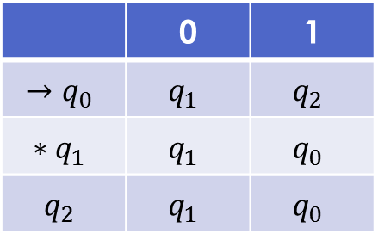


有限自动机的其他表示法
0
Start
0
Transition diagram
$Q$: set of nodes
$δ$: arrows between nodes
$q_{0}$: start arrow
$F$: double circle
Transition table
rows: states
columns: inputs
entry value: $δ(q,a)$
$$q_{0}$$
$$q_{1}$$
1
1
1
0
$$q_{2}$$
 | 0 | 1
$${→q}_{0}$$ | $$q_{1}$$ | $$q_{2}$$
$${∗q}_{1}$$ | $$q_{1}$$ | $$q_{0}$$
$$q_{2}$$ | $$q_{1}$$ | $$q_{0}$$

Slide 4

自动机接受的字符串
An automaton accepts a string
a string is a sequence of input symbols $<a_{1}a_{2}…a_{n}>$
an automaton starts from its initial state $q_{0}$ and processes the first symbol in the sequence by consulting $δ(q_{0},a_{1})$
if $δ\left(q_{0},a_{1}\right)=q_{1}$, then it enters state $q_{1}$ and processes the next symbol in the sequence
it continues until it reaches the last state $q_n$ with $δ\left(q_{n−1},a_{n}\right)=q_{n}$
if $q_{n}∈F$, we say the automata terminates and accepts the string $<a_{1}a_{2}…a_{n}>$; otherwise, we say it rejects the string

Slide 5

自动机接受的语言
Define an extended transition function $\hat{δ}$ from $δ$ $\hat{δ}:Q×Σ^{∗}→Q$
Basis: $\hat{δ}\left(q,ε\right)=q$
Induction: $\hat{δ}\left(q,xa\right)=δ(\hat{δ}\left(q,x\right),a)$
The language accepted by an automata M
$L\left(M\right)=\left\{w \right| w∈Σ^{∗}∧\hat{δ}\left(q_{0},w\right)∈F\}$

Slide 6












Example
What is the language accepted by this DFA?
$L\left(M\right)=\{a^{n}b^{m}|n,m≥1\}$
State D is a deadlock state
$$a$$
$$b$$
Start
$$a$$
$$b$$
$$q_{0}$$
$$q_{1}$$
$$q_{2}$$
$$b$$
$$a$$
$$D$$
$$a,b$$

Slide 7
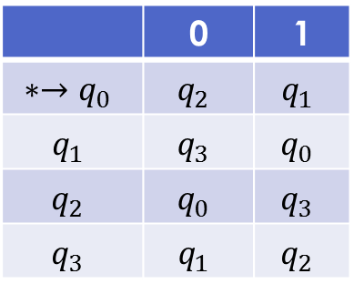

Example
Design a DFA to accept language $L=\{ω|ω has even number of 0 and even number of 1\}$
States
$q_{0}$: have seen even num of 0 and 1 both
$q_{1}$: have seen even num of 0 and odd num of 1
$q_{2}$: have seen odd num of 0 and even num of 1
$q_{3}$: have seen odd num of 0 and 1 both
Transitions
 | 0 | 1
$$∗→q_{0}$$ | $$q_{2}$$ | $$q_{1}$$
$$q_{1}$$ | $$q_{3}$$ | $$q_{0}$$
$$q_{2}$$ | $$q_{0}$$ | $$q_{3}$$
$$q_{3}$$ | $$q_{1}$$ | $$q_{2}$$

Slide 8
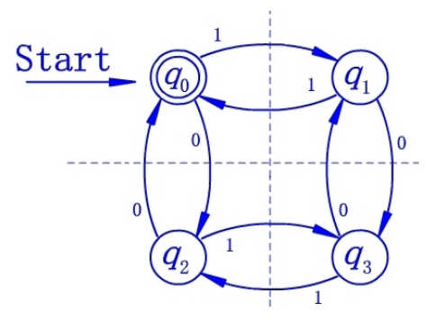




Example
Transition diagram
Start
1
$$q_{0}$$
$$q_{1}$$
1
0
0
0
0
1
$$q_{2}$$
$$q_{3}$$
1

Slide 9
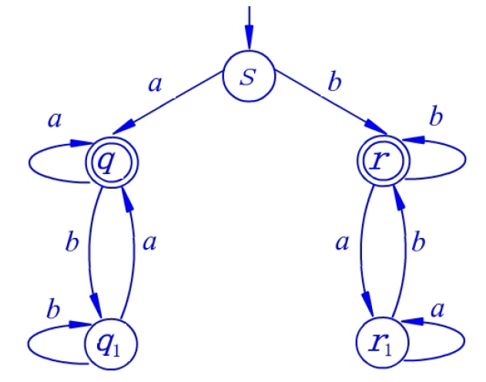

Example
Design a DFA to accept all strings that start and end with a or start and end with b for $Σ=\{a,b\}$.

Slide 10
课堂练习
给出接受以下语言的DFA
所有以01结尾的串
所有串都含有011子串
0的个数被3整除，1的个数被2整除的串

Slide 11









答案
1. 所有以01结尾的串
$$1$$
$$0$$
$$q_{0}$$
$$q_{1}$$
$$1$$
$$q_{2}$$
Start
$$0$$
$$0$$
$$1$$

Slide 12











答案
2. 所有串都含有011子串
$$1$$
$$0$$
$$0,1$$
$$q_{0}$$
$$0$$
$$q_{1}$$
$$1$$
$$q_{2}$$
$$1$$
$$q_{3}$$
Start
$$0$$

Slide 13


















答案
3. 0的个数被3整除，1的个数被2整除的串
$$0$$
$$a_{0}b_{1}$$
$$a_{1}b_{1}$$
$$1$$
$$1$$
$$1$$
$$1$$
$$0$$
$$a_{0}b_{0}$$
$$a_{1}b_{0}$$
Start
$$0$$
$$0$$
$$0$$
$$0$$
$$a_{2}b_{0}$$
$$1$$
$$1$$
$$a_{2}b_{1}$$

Slide 14
作业
给出接受以下语言的DFA
所有以1开头，能被5整除的二进制串，如101, 1010, 1111

Slide 15






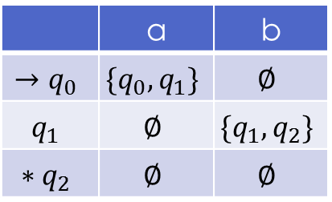


不确定的有限状态自动机(NFA)
An nondeterministic finite automaton $NFA=(Q,Σ,δ,q_{0},F)$
$Q$ is a finite set of state
$Σ$ is a finite set of input symbols
$δ:Q×Σ→2^{Q}$ is a transition function
$q_{0}$ is a start state
$F$ is a set of final (accepting) states
Example
$Q=\{q_{0},q_{1},q_{2}\}$
$Σ=\{0,1\}$
$δ(q_{0},a)=\{q_{0},q_{1}\}$, $δ\left(q_{1},b\right)=\{q_{1},q_{2}\}$
$F=\{q_{2}\}$
$$a$$
$$b$$
Start
$$a$$
$$b$$
$$q_{0}$$
$$q_{1}$$
$$q_{2}$$
 | a | b
$$→q_{0}$$ | $$\{q_{0},q_{1}\}$$ | $$∅$$
$$q_{1}$$ | $$∅$$ | $$\{q_{1},q_{2}\}$$
$$∗q_{2}$$ | $$∅$$ | $$∅$$

Slide 16

NFA接受的语言
Extend $δ$ to $\hat{δ}:Q×Σ^{∗}→2^{Q}$
$\hat{δ}\left(q,ε\right)≝\{q\}$
$\hat{δ}\left(q,xa\right)≝\bigcup_{p∈\hat{δ}\left(q,x\right)}{δ\left(p,a\right)}$
A string is accepted by a NFA iff there exists a path corresponding to the string from the start state to a final state
Language accepted by a NFA N
$L\left(N\right)=\left\{ w \right| \hat{δ}\left(q_{0},w\right)∩F≠∅ \}$

Slide 17













Example
Design a NFA to accept the following language
$${\left(0 | 1\right)}^{∗}\left(00 | 11\right){\left(0 | 1\right)}^{∗}$$
$$0,1$$
$$0,1$$
Start
$$0$$
$$0$$
$$q_{0}$$
$$q_{1}$$
$$q_{2}$$
$$1$$
$$q_{3}$$
$$1$$
$$q_{4}$$
$$0,1$$

Slide 18
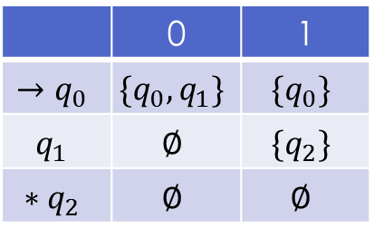






Example
Design a NFA to accept all strings that end with 01
$$0,1$$
Start
$$0$$
$$1$$
$$q_{0}$$
$$q_{1}$$
$$q_{2}$$
 | 0 | 1
$$→q_{0}$$ | $$\{q_{0},q_{1}\}$$ | $${\{q}_{0}\}$$
$$q_{1}$$ | $$∅$$ | $$\{q_{2}\}$$
$$∗q_{2}$$ | $$∅$$ | $$∅$$

Slide 19

NFA和DFA的等价性
If a language can be accepted by a NFA, it can be accepted by a DFA
Proof: Let $N=(Q_{N}, Σ, δ_{N}, q_{0},F_{N})$ be a NFA. Construct a DFA $D=(Q_{D},Σ,δ_{D},{\{q}_{0}\},F_{D})$ where
$Q_{D}=\left\{S\right|S⊆Q_{N}\}$
$F_{D}=\left\{S\right|S⊆Q_{N}∧S∩F_{N}≠∅\}$
For any $S⊆Q_{N}$ and input symbol $a∈Σ$, $δ_{D}\left(S,a\right)=\bigcup_{p∈S}{δ_{N}(p,a)}$

Slide 20
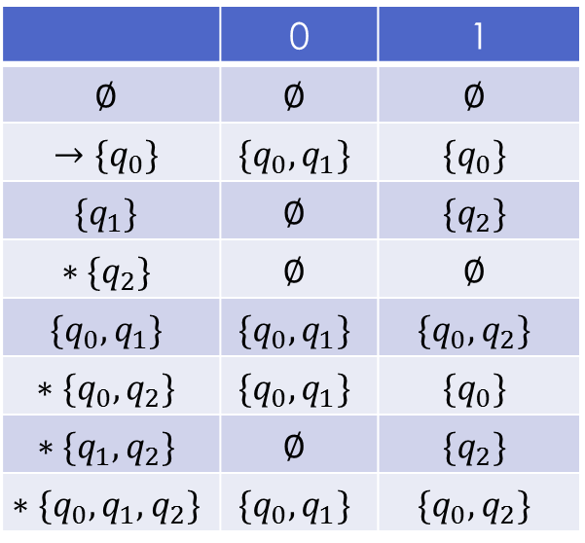
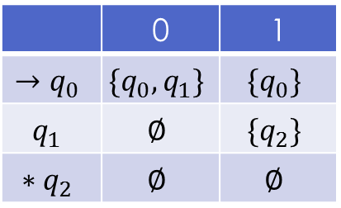
Example
 | 0 | 1
$$→q_{0}$$ | $$\{q_{0},q_{1}\}$$ | $${\{q}_{0}\}$$
$$q_{1}$$ | $$∅$$ | $$\{q_{2}\}$$
$$∗q_{2}$$ | $$∅$$ | $$∅$$
Given the following NFA
The constructed DFA is
 | 0 | 1
$$∅$$ | $$∅$$ | $$∅$$
$$→\{q_{0}\}$$ | $$\{q_{0},q_{1}\}$$ | $${\{q}_{0}\}$$
$$\{q_{1}\}$$ | $$∅$$ | $$\{q_{2}\}$$
$$∗{\{q}_{2}\}$$ | $$∅$$ | $$∅$$
$$\{q_{0},q_{1}\}$$ | $$\{q_{0},q_{1}\}$$ | $$\{q_{0},q_{2}\}$$
$$∗\{q_{0},q_{2}\}$$ | $$\{q_{0},q_{1}\}$$ | $$\{q_{0}\}$$
$$∗\{q_{1},q_{2}\}$$ | $$∅$$ | $$\{q_{2}\}$$
$$∗\{q_{0},q_{1},q_{2}\}$$ | $$\{q_{0},q_{1}\}$$ | $$\{q_{0},q_{2}\}$$

Slide 21

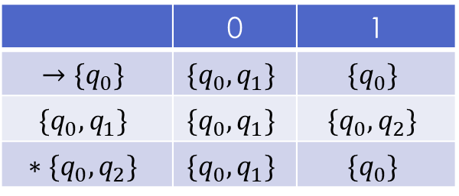


Example
Remove unreachable states
 | 0 | 1
$$→\{q_{0}\}$$ | $$\{q_{0},q_{1}\}$$ | $${\{q}_{0}\}$$
$$\{q_{0},q_{1}\}$$ | $$\{q_{0},q_{1}\}$$ | $$\{q_{0},q_{2}\}$$
$$∗\{q_{0},q_{2}\}$$ | $$\{q_{0},q_{1}\}$$ | $$\{q_{0}\}$$
$$1$$
$$0$$
$${\{q}_{0}\}$$
$${\{q_{0},q}_{1}\}$$
$$1$$
$${\{q_{0},q}_{2}\}$$
Start
$$0$$
$$0$$
$$1$$

Slide 22

NFA和DFA的等价性
Given a string w, we need to prove ${\hat{δ}}_{D}\left(\left\{q_{0}\right\},w\right)={\hat{δ}}_{N}(q_{0},w)$
Induction by the length of w
Basis: $\left|w\right|=0$, we have ${\hat{δ}}_{D}\left(\left\{q_{0}\right\},ε\right)={\hat{δ}}_{N}\left(q_{0},ε\right)=\{q_{0}\}$
Induction: assume that ${\hat{δ}}_{D}\left(\left\{q_{0}\right\},w\right)={\hat{δ}}_{N}\left(q_{0},w\right)$ for $\left|w\right|=n$, consider the case when $\left|w\right|=n+1$
Let $w=xa$ and ${\hat{δ}}_{D}\left(\left\{q_{0}\right\},x\right)={\hat{δ}}_{N}\left(q_{0},x\right)$
${\hat{δ}}_{D}\left(\left\{q_{0}\right\},xa\right)$ definition of ${\hat{δ}}_{D}$
$=δ_{D}\left({\hat{δ}}_{D}\left(\left\{q_{0}\right\},x\right),a\right)$ inductive hypothesis
$=δ_{D}\left({\hat{δ}}_{N}\left(q_{0},x\right),a\right)$ construction
$=\bigcup_{p∈{\hat{δ}}_{N}\left(q_{0},x\right)}{δ_{N}\left(p,a\right)}$ definition of ${\hat{δ}}_{N}$
$={\hat{δ}}_{N}\left(q_{0},xa\right)$

Slide 23
Application of FA: Text search
Design a NFA to do the task
Convert the NFA to an equivalent DFA
Simplify the DFA by removing unreachable states and merging equivalent states

Slide 24
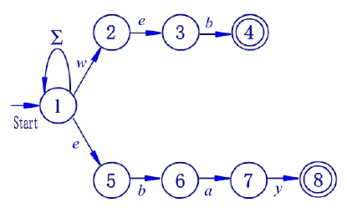

Design a NFA recognizing web and ebay
There is a start state with a transition to itself on every input symbol.
For each keyword $a_{1}a_{2}…a_{k}$, there are k states, say $q_{1},q_{2},…,q_{k}$. There is a transition from the start state to $q_{1}$ on symbol $a_{1}$, a transition from $q_{1}$ to $q_{2}$ on symbol $a_{2}$, and so on. The state $q_{k}$ is an accepting state and indicates that keyword $a_{1}a_{2}…a_{k}$ has been found.

Slide 25

Convert to equivalent DFA
If $q_{0}$ is the start state of the NFA, then $\{q_{0}\}$ is one of the states of the DFA.
Suppose $p$ is one of the NFA states, and it is reached from $q_{0}$ along a path whose symbols are $a_{1}a_{2}…a_{m}$. Then one of the DFA states is the set of NFA states consisting of:
$q_{0},p$ and every other state of the NFA that is reachable from $q_{0}$ by following a path whose labels are a suffix of $a_{1}a_{2}…a_{m}$, that is, any sequence of symbols of the form $a_{j}a_{j+1}…a_{m}$.
The transition for each of the DFA states can be calculated by the formula $δ_{D}\left(S,a\right)=\bigcup_{p∈S}{δ_{N}(p,a)}$

Slide 26
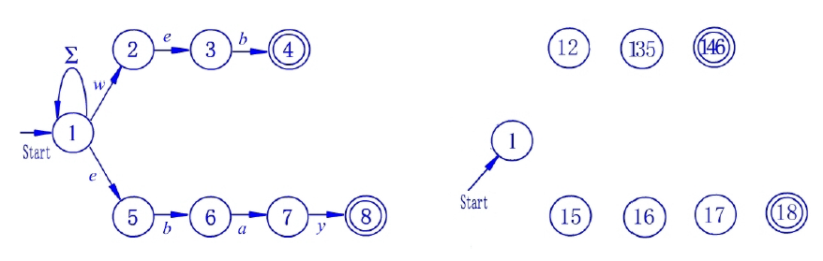
Convert to equivalent DFA

Slide 27
Convert to equivalent DFA

Slide 28












带空迁移的有限自动机
A nondeterministic finite automate with $ε$-transition is a quintuple $(Q,Σ,δ,q_{0},F)$
$Q$ is a finite set of state
$Σ$ is a finite set of input symbols
$δ:Q×Σ∪\{ε\}→2^{Q}$ is a transition function
$q_{0}$ is a start state
$F$ is a set of final (accepting) states
$$a$$
$$b$$
$$c$$
$$d$$
Start
$$ε$$
$$b$$
$$ε$$
$$q_{0}$$
$$q_{1}$$
$$q_{2}$$
$$q_{3}$$

Slide 29


Language of $ε$-NFA
Extended transition function $\hat{δ}$
Basis: $\hat{δ}\left(q,ε\right)=ε_closure(q)$
Inductive: $\hat{δ}\left(q,xa\right)=\bigcup_{r∈δ(\hat{δ}\left(q,x\right),a)}{ε_closure(r)}$ where $δ\left(S,a\right)=\bigcup_{p∈S}{δ(p,a)}$
Language of $ε$-NFA
$L\left(A\right)=\left\{w \right| \hat{δ}\left(q_{0},w\right)∩F≠∅\}$

Slide 30

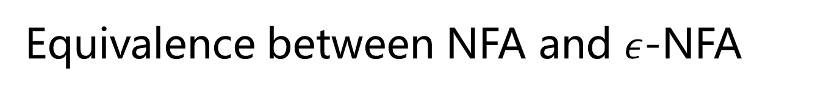
Equivalence between NFA and $ε$-NFA
A language L can be accepted by a $ε$-NFA, it can be also accepted by a NFA
Proof: Construct an equivalent NFA=$(Q,Σ,δ^{′},q_{0},F^{′})$ from $ε$-NFA
$F^{′}=F∪\{q_{0}\}$ if $ε_closure\left(q_{0}\right)∩F≠∅$, otherwise, $F^{′}=F$
$δ^{′}\left(q,a\right)=\hat{δ}(q,a)$
Proof ${\hat{δ}}^{′}\left(q_{0},w\right)=\hat{δ}(q_{0},w)$
Basis: $\left|w\right|=1$, ${\hat{δ}}^{′}\left(q_{0},a\right)=δ′(q_{0},a)=\hat{δ}(q_{0},a)$
Induction: $w=xa$, ${\hat{δ}}^{′}\left(q_{0},xa\right)=\bigcup_{r∈δ({\hat{δ}}^{′}\left(q_{0},x\right),a)}{ε_closure(r)}$ $=\bigcup_{r∈δ(\hat{δ}\left(q_{0},x\right),a)}{ε_closure(r)}$ $=\hat{δ}(q_{0},xa)$

